Slide 1

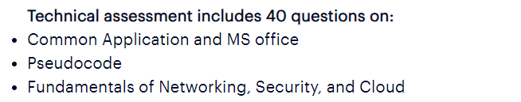
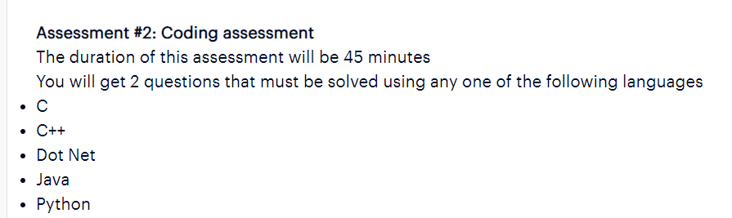
Accenture Technical MCQ Complete Paper Solved

Slide 2
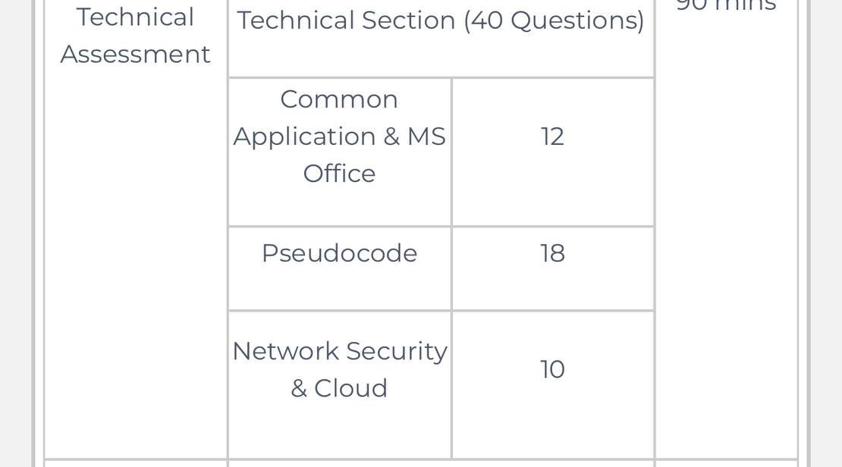
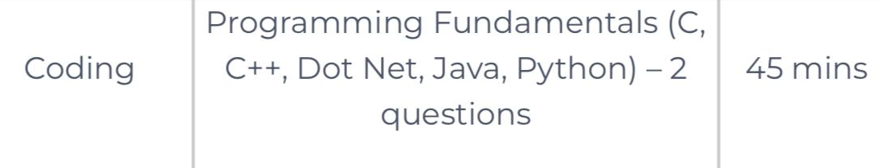
Accenture Technical MCQ Complete Paper Solved

Slide 3
Accenture Technical MCQ Complete Paper Solved
Accenture Syllabus
Accenture Common Applications & MS Office Syllabus
• MS Office (Word, PowerPoint, Excel, Outlook)
• Browsers' fundamentals
• Shortcut keys
• Command prompt
• Working flow of keys
Accenture Network Security Syllabus
• Basics of Networking
• Network Security
• Encryption standards & Algorithms
• Network security devices
• Attack types
• Firewalls
Accenture Cloud Syllabus
• Fundamentals of Cloud Computing
• Client server architecture
• Cloud data centres
• Cloud service providers
• Cloud Service Platforms

Slide 4
Accenture Technical MCQ Complete Paper Solved
Accenture Syllabus
Accenture Pseudocode Syllabus
• Programming Fundamentals
• Looping
• Arrays
• Recursion
• Function
• Bitwise Operators
• Increment & Decrement Operators
• Conditional statements
• Basics of Data Structures

Slide 5
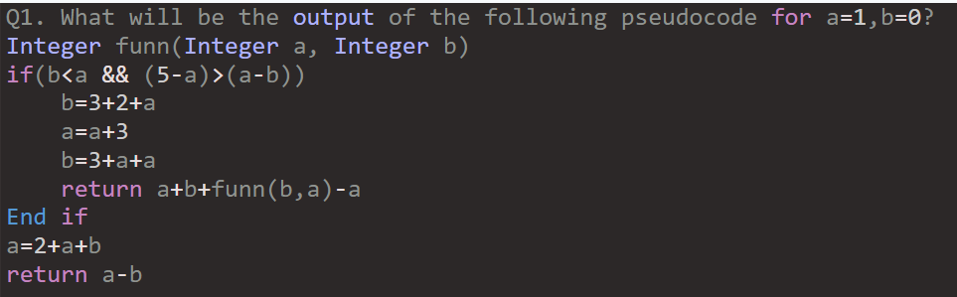
Accenture Pseudocode: 18 Questions
32
28
21
24

Slide 6
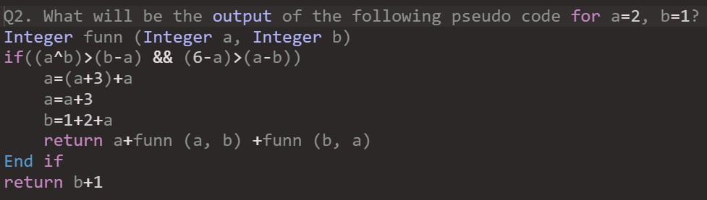
Accenture Actual Pseudo Codes & Solutions

Slide 7
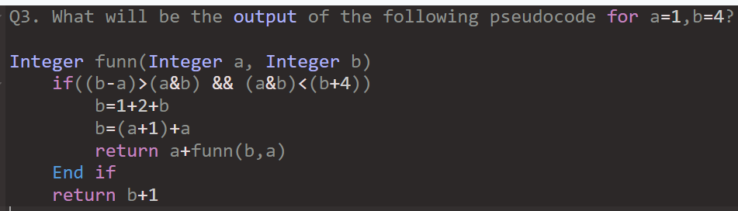
Accenture Actual Pseudo Codes & Solutions
4
21
-15
3

Slide 8
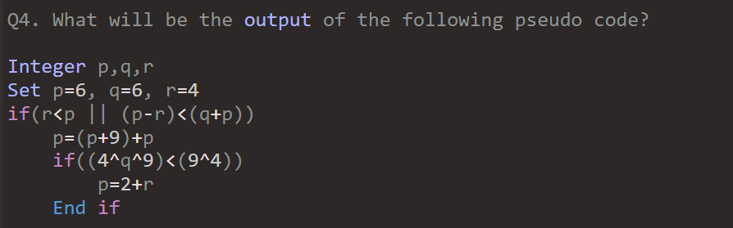
Accenture Actual Pseudo Codes & Solutions

Slide 9
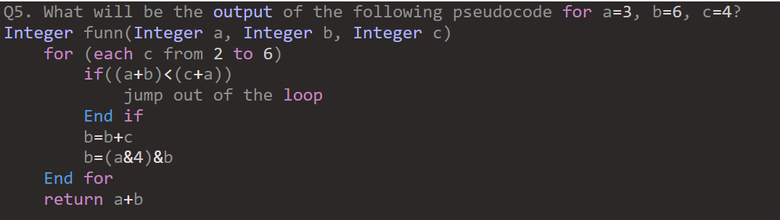
Accenture Actual Pseudo Codes & Solutions
10
13
0
3

Slide 10
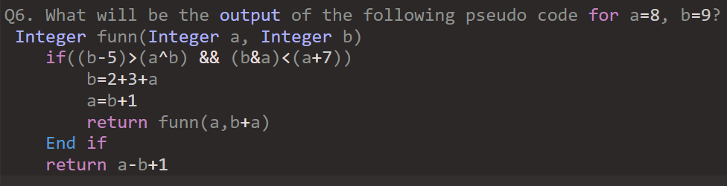
Accenture Actual Pseudo Codes & Solutions
-18
-17
-9
-20

Slide 11
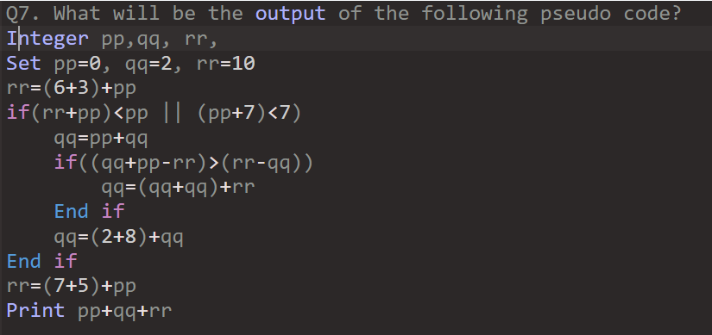
Accenture Actual Pseudo Codes & Solutions
23
18
10
14

Slide 12
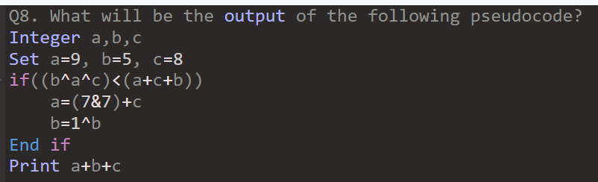
Accenture Actual Pseudo Codes & Solutions
46
35
13
27

Slide 13
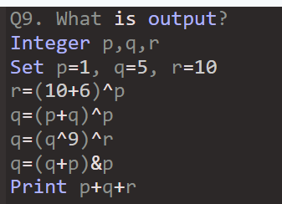
Accenture Actual Pseudo Codes & Solutions
18
27
21
14

Slide 14
Accenture Actual Pseudo Codes & Solutions
Q10. Predict the output of the following pseudocode for x = 10, y = 5.
Integer solve(Integer x, Integer y)
if(y > 0)
if(x > 0)
return x + y + solve(2, y - 5) + solve(x - 10, 1)
End if
End if
return x + y
End function solve()
15
18
13
17

Slide 15
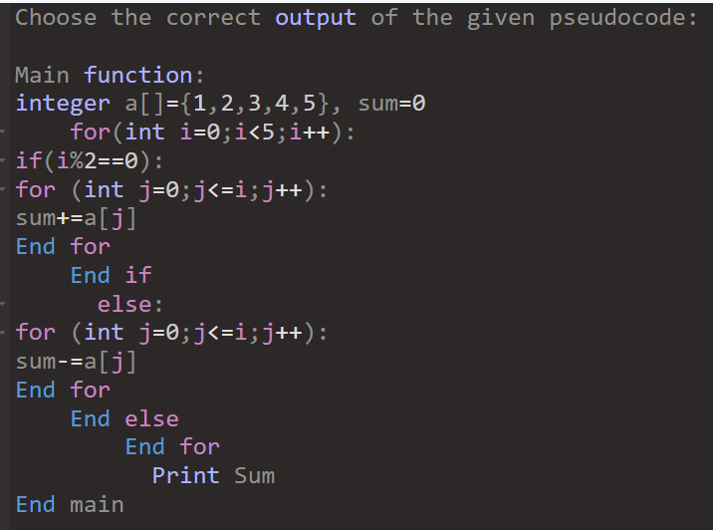
Accenture Actual Pseudo Codes & Solutions
Q11.
0.0
9.0
8.0
4.0

Slide 16
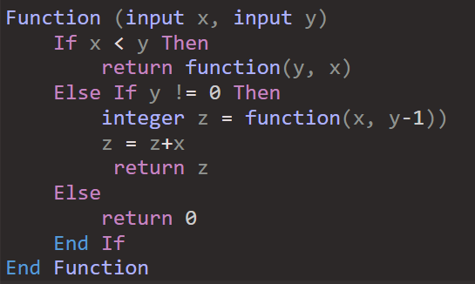
Accenture Actual Pseudo Codes & Solutions
Q12.
6
7
8
10

Slide 17
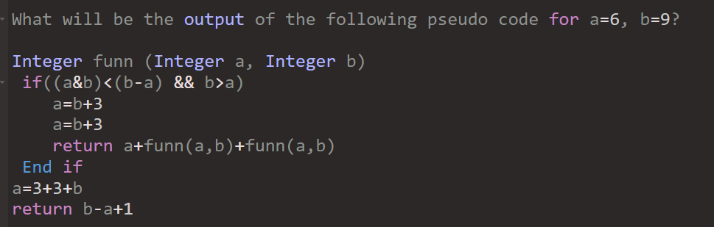
Accenture Actual Pseudo Codes & Solutions
Q13.
2
12
4
-3

Slide 18
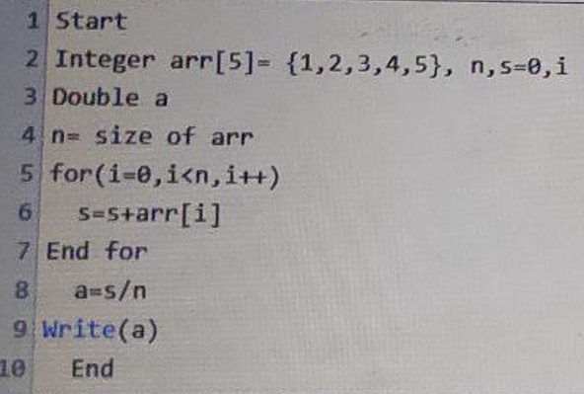
Accenture Actual Pseudo Codes & Solutions
Q14.
3.0
15.0
5.0
0.0

Slide 19
Accenture Actual Pseudo Codes & Solutions
Q15.
Calculate the output of the following pseudocode.
Integer w, x, y, z
Set w = 1, x = 1
for (each y from 11 to 20 )
for (each z from -3 to 0 )
w = w + 5
if(w > y)
Continue
End if
w = 1
if(w > z)
Jump out of the loop
End if
End for
End for
Print w + x
2
3
22
8

Slide 20
Accenture Actual Pseudo Codes & Solutions
Q16.
Predict the output of the following pseudocode for n = 5, m = 6.
Integer solve(Integer n, Integer m )
if(n > 4 && m < 7)
return solve(n +1, m + 1)
Else
Return n + m
End if
End function solve()
15
21
13
10

Slide 21
Accenture Actual Pseudo Codes & Solutions
Q17.
Calculate the output of the following pseudocode.
Integer w, x, y, z
Set w = 21, x = 11
for (each y from 21 to 30 )
for (each z from -1 to 0 )
w = w - 1
if(w > y)
Continue
End if
w = 1
if(w > z)
Jump out of the loop
End if
End for
End for
Print w + x
8
12
3
2

Slide 22
Accenture Actual Pseudo Codes & Solutions
Q18.
Predict the output of the following pseudocode for a = 11, b = 12.
Integer solve(Integer a, Integer b )
if(a < 3 && b < 4)
return solve(a + 1, b + 1)
Else
Return a + b
End if
End function solve()
13
12
22
23

Slide 23
Accenture Common Applications & MS Office: 12 Questions
Q1. Which of the following can be used to close a tab on a browser?
Ctrl+T
Ctrl+A
Ctrl+W
Ctrl+X
Option: c
Q2. The space between the margin and the text is called ________.
Line spacing
Paragraph spacing
Indent
Index
Option: c

Slide 24
Accenture Common Applications & MS Office: 12 Questions
Q3. In MS-PowerPoint, which key on the keyboard can be use to view slide show?
F1
F2
F5
F10
Option: 3

Slide 25
Accenture Common Applications & MS Office: 12 Questions
Q4. Which key is to be held down to select the word or phrase to be selected in MS Word?
Alt
Shift
Ctrl
Tab
Option: 2

Slide 26
Accenture Common Applications & MS Office: 12 Questions
Q5. Which of the following commands will take you two steps backward from any particular directory?
cd../
cd../..
cd ..\
cd ..\..\
Option: 2

Slide 27
Accenture Common Applications & MS Office: 12 Questions
Q6. If by an accident a mail is deleted, then which of the following folders will save the mail.
Draft
Spam
Inbox
Trash
Option: D

Slide 28
Accenture Common Applications & MS Office: 12 Questions
Q7. How many columns can you insert into a word document at most?
45
50
63
65

Slide 29
Accenture Common Applications & MS Office: 12 Questions
Q8.Starting with Microsoft Office 2003, Photo Editor was renamed to
Manager
Picture Manager
Picture Editor
Paint Editor
Option: B

Slide 30
Accenture Common Applications & MS Office: 12 Questions
Q9. Which of the following view options in MS Word shows the contents of a document as bulleted points?
Draft
Web Layout
Outline
Print Layout
Option: 3

Slide 31
Accenture Common Applications & MS Office: 12 Questions
Q10. Which feature in Microsoft Outlook should David utilize to schedule a recurring email reminder to his team every Friday at 9:00 AM?
Delay Delivery
Recurrence
Follow Up
Categories

Slide 32
Accenture Common Applications & MS Office: 12 Questions
Q11. What is the function of the “Eyedropper” tool in MS Powerpoint?
Change the color of text or shapes by selecting an existing color on the slide
Add gradients or textures to objects
Insert Clip art or stock images
Control the order of slides in the presentation

Slide 33
Accenture Common Applications & MS Office: 12 Questions
Q12. What comparison operator is NOT allowed to be used in a conditional formatting formula in Microsoft Excel?
==
<
><
<=

Slide 34
Accenture Network Security & Cloud: 10 Questions
Q1. Which of the following security standard has the possibility of breaking the encryption during the initial 4- way handshake ?
WPA2
WEP
Both WPA and WPA2
WPA
Option: C

Slide 35
Accenture Network Security & Cloud: 10 Questions
Q2. Which of the following cloud service provider does not provide application lifecycle management?
Azure
Google cloud platform
AWS
All of the mentioned provides this service
Option: All of the mentioned provides

Slide 36
Accenture Network Security & Cloud: 10 Questions
Q3. Which of the following types of network security ensures that potential attackers cannot infiltrate your network?
Network access control
Firewall
Virtual Private Network
Both Network access control and VPN
Option: C

Slide 37
Accenture Network Security & Cloud: 10 Questions
Q4. In the SSLv3 the padding bits are ____________ with the secret key.
Padded
XORed
Concatenated
ANDed
Option: C

Slide 38
Accenture Network Security & Cloud: 10 Questions
Q5. Which of the following statements is true about cloud and data center?
1. In Cloud, owner is responsible for downtime and repairs
2. In Data center, owner is responsible for downtime and repairs
Choose the correct answer from the options given below.
Neither 1 nor 2
Only 2
Only 3
Both 1 and 2
Option: Only 2

Slide 39
Accenture Network Security & Cloud: 10 Questions
Q6. How many phases are there in Cloud Computing Planning?
1
5
3
6
Option: 3

Slide 40
Accenture Network Security & Cloud: 10 Questions
Q7. Consider a situation where you have to choose between the major cloud service providers. Which would you choose if you want support for Linux, Windows Server, and SQL Server and enhanced security?
Oracle
Google Cloud
Alibaba Cloud
Azure

Slide 41
Accenture Network Security & Cloud: 10 Questions
Q8. In which one of the following, a strategy record or Document is created respectively to the events, conditions a user may face while applying cloud computing mode.
Cloud Computing Value Proposition
Cloud Computing Strategy Planning
Planning Phase
Business Architecture Development
Option: B

Slide 42
Accenture Network Security & Cloud: 10 Questions
Q9. How does WPA2 differ from WPA?
It uses CCMP based on AES as an encryption algorithm user
It used pre-shared key or 802.1x as authentication methods and CCMP based on AES as an Encryption algorithm user
The password is cracked during the initial 4-way handshaked.
It uses pre-shared key 802.1x as authentication methods
Option: A

Slide 43
Accenture Network Security & Cloud: 10 Questions
Q10. Which of the following keystreams is generated by the concatenation of shared secret40-bits key and 24-bit IV?
Data Encryption Standard
Rivest Cipher 5
Advanced Encryption Standard
Rivest Cipher 4
Option: D

